Slide 1
Twitter Sentiment Analysis
PRINCE GARG RISHI SRIVASTAVA
18103071 18103079
Github Link

Slide 2
Content
Introduction
Problem Statement
Challenges
Process-Flow
Classifiers
Analysis and Results

Slide 3
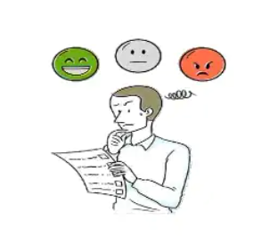
Introduction
Sentiment Analysis is the process of determining whether a piece of writing is positive or negative

Slide 4
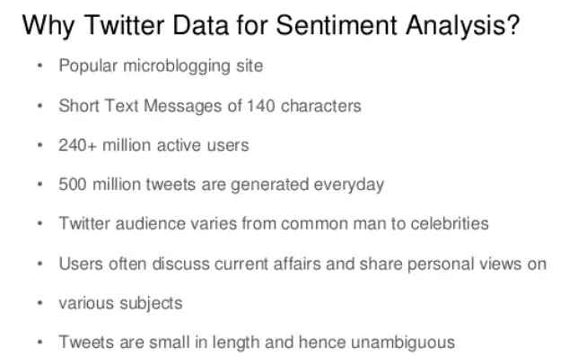

Slide 5
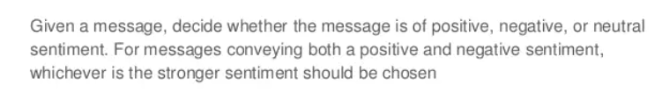
Problem Statement

Slide 6
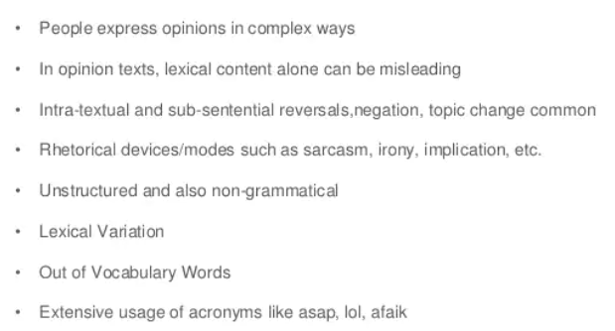
Challenges

Slide 7
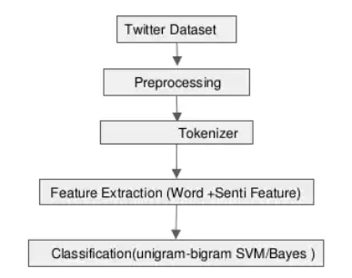
Process Flow

Slide 8
Classifiers

Slide 9
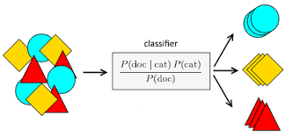
Naïve Bayes
NAIVE BAYES CLASSIFIERS ARE A COLLECTION OF CLASSIFICATION ALGORITHMS BASED ON BAYES' THEOREM

Slide 10
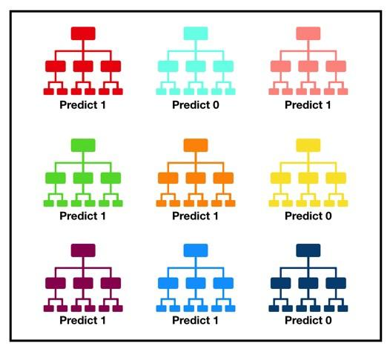
Random Forest
THE RANDOM FOREST IS A CLASSIFICATION ALGORITHM CONSISTING OF MANY DECISIONS TREES. IT USES BAGGING AND FEATURE RANDOMNESS WHEN BUILDING EACH INDIVIDUAL TREE TO TRY TO CREATE AN UNCORRELATED FOREST OF TREES WHOSE PREDICTION BY COMMITTEE IS MORE ACCURATE THAN THAT OF ANY INDIVIDUAL TREE.

Slide 11
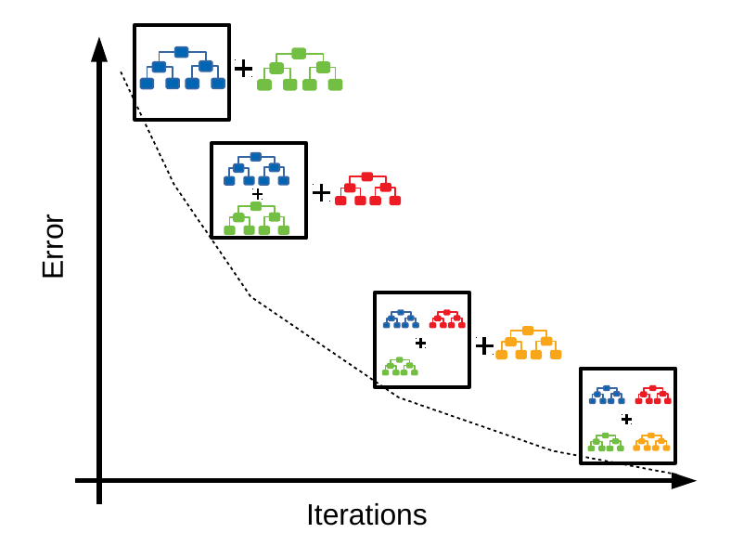
Gradient boost
Gradient boosting classifiers are a group of machine learning algorithms that combine many weak learning models together to create a strong predictive model. Decision trees are usually used when doing gradient boosting

Slide 12

Decision Tree
Decision trees (dts) are a non-parametric supervised learning method used for classification and regression. The goal is to create a model that predicts the value of a target variable by learning simple decision rules inferred from the data features. A tree can be seen as a piecewise constant approximation.

Slide 13
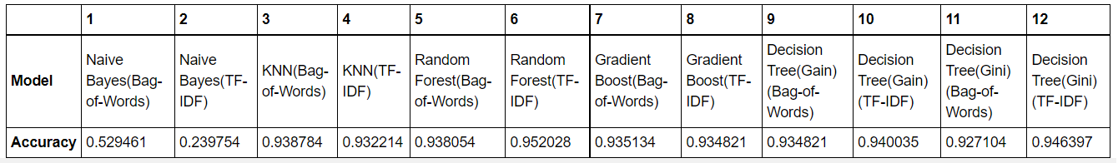
Results

Slide 14
Thank You

